Slide 1

Detection of
Intracranial Hemorrhage
on CT scan images using Convolutional Neural Networks
A thesis presented to
Department of Computer Science and Engineering
BRAC University

Slide 2
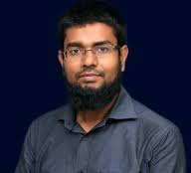






TEAM
Dr Mohammad Zavid Parvez
Supervisor
Dewan Ziaul Karim
Co-supervisor
Afridi Ibn Rahman
17201107
Subhi Bhuiyan
17201116
Ziad Hasan Reza
17201076
Jasarat Zaheen
17201100
Tasin Al Nahian Khan
17201085

Slide 3
OUTLINE OF CONTENTS
01
02
03
04
INTRODUCTION
RELATED WORK
THE DATA
05
06
MODEL EVALUATION
DISCUSSION
MODEL DEVELOPMENT
07
CONCLUSION

Slide 4
01
INTRODUCTION
By Subhi Bhuiyan

Slide 5
15,000,000
15 million people worldwide suffer from stroke annually.
Stroke is a leading cause of permanent disability and even death.

Slide 6
STROKE TYPOLOGY
INTRACRANIAL HEMORRHAGE
HEMORRHAGE
STROKE
ISCHEMIC

Slide 7
PREVALENCE
ACCESSIBILITY
EXPENSIVE
EXPERTISE
Nearly two-thirds of
the global population lack
proper access to advanced
stroke diagnostics and specialists.

Slide 8

CT Scans
MRI
Deep Learning is widely used in interpreting medical images
and has shown promising advancements.
Convolutional Neural Network (CNN) on neuroimaging with transfer learning techniques to assist in the diagnosis of intracranial hemorrhage on CT scans.

Slide 9
Research Objectives
Improve clinical diagnosis by AI
Convolutional Neural Network
01
02
03
04
Detection &
Binary Classification
Transfer Learning
Approach

Slide 10
02
RELATED WORK
By Subhi Bhuiyan

Slide 11
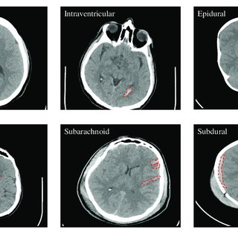
CT Images for Intracranial Hemorrhage Detection and Segmentation :
Hssayeni et al
Developed and released the dataset
U-Net model
Detection accuracy of 87%

Slide 12
Synergic Deep-learning model for Automated Detection and Classification:
Anupama et al
GD-SDL model
Detect ICH in wearable networks
Gabor filtering for noise removal
Accuracy of 95.73%

Slide 13
Smart Machine Learning Model of Hemorrhage Diagnosis based IoT:
Chen et al
Support Vector Machine (SVM)
Feedforward Neural Network
80.67%
86.70%

Slide 14
Accuracy Review on this Dataset
U-Net
GD-SDL
SVM
FNN
87%
95.73%
80.67%
86.70%
EfficientNetB6
95.99%

Slide 15
03
THE DATA
By Jasarat Zaheen

Slide 16
The Physionet Repository
The dataset has been collected
Al Hilla Teaching Hospital-Iraq
A retrospective study was conducted
Feb-Aug
2018
A total of 5001 images are collected from 82 patients
30 images per patient were collected on an average

Slide 17
Dataset Organizing
1104
CT images were of hemorrhage
A total of 5001 images are accumulated
2501
images are of brain CT scans to train the CNN models for our research
2501
images are of brain CT scans
2500
images are of bones
1397
were normal brain CT images

Slide 18
Subject demographics
Total number of subjects | 82 | Sex (Male, Female) | 46M, 36F
Age(years) | 27.8 ± 19.5 | Age Range | 1 day – 72 years
Number of Normal (healthy) | 46 | Number of subjects with ICH | 36

Slide 19
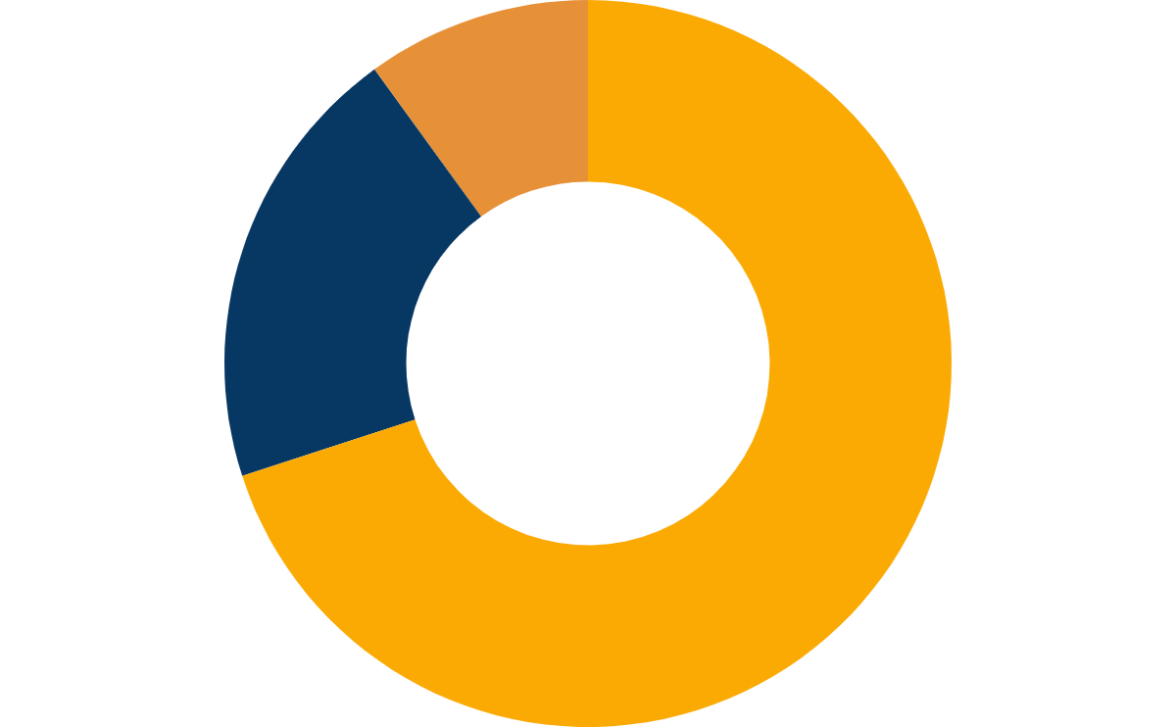
Dataset Splitting
Test
Total images: 250
Validation
Total images: 450
10%
Train
Total images: 1801
40%
70%
20%
25%

Slide 20
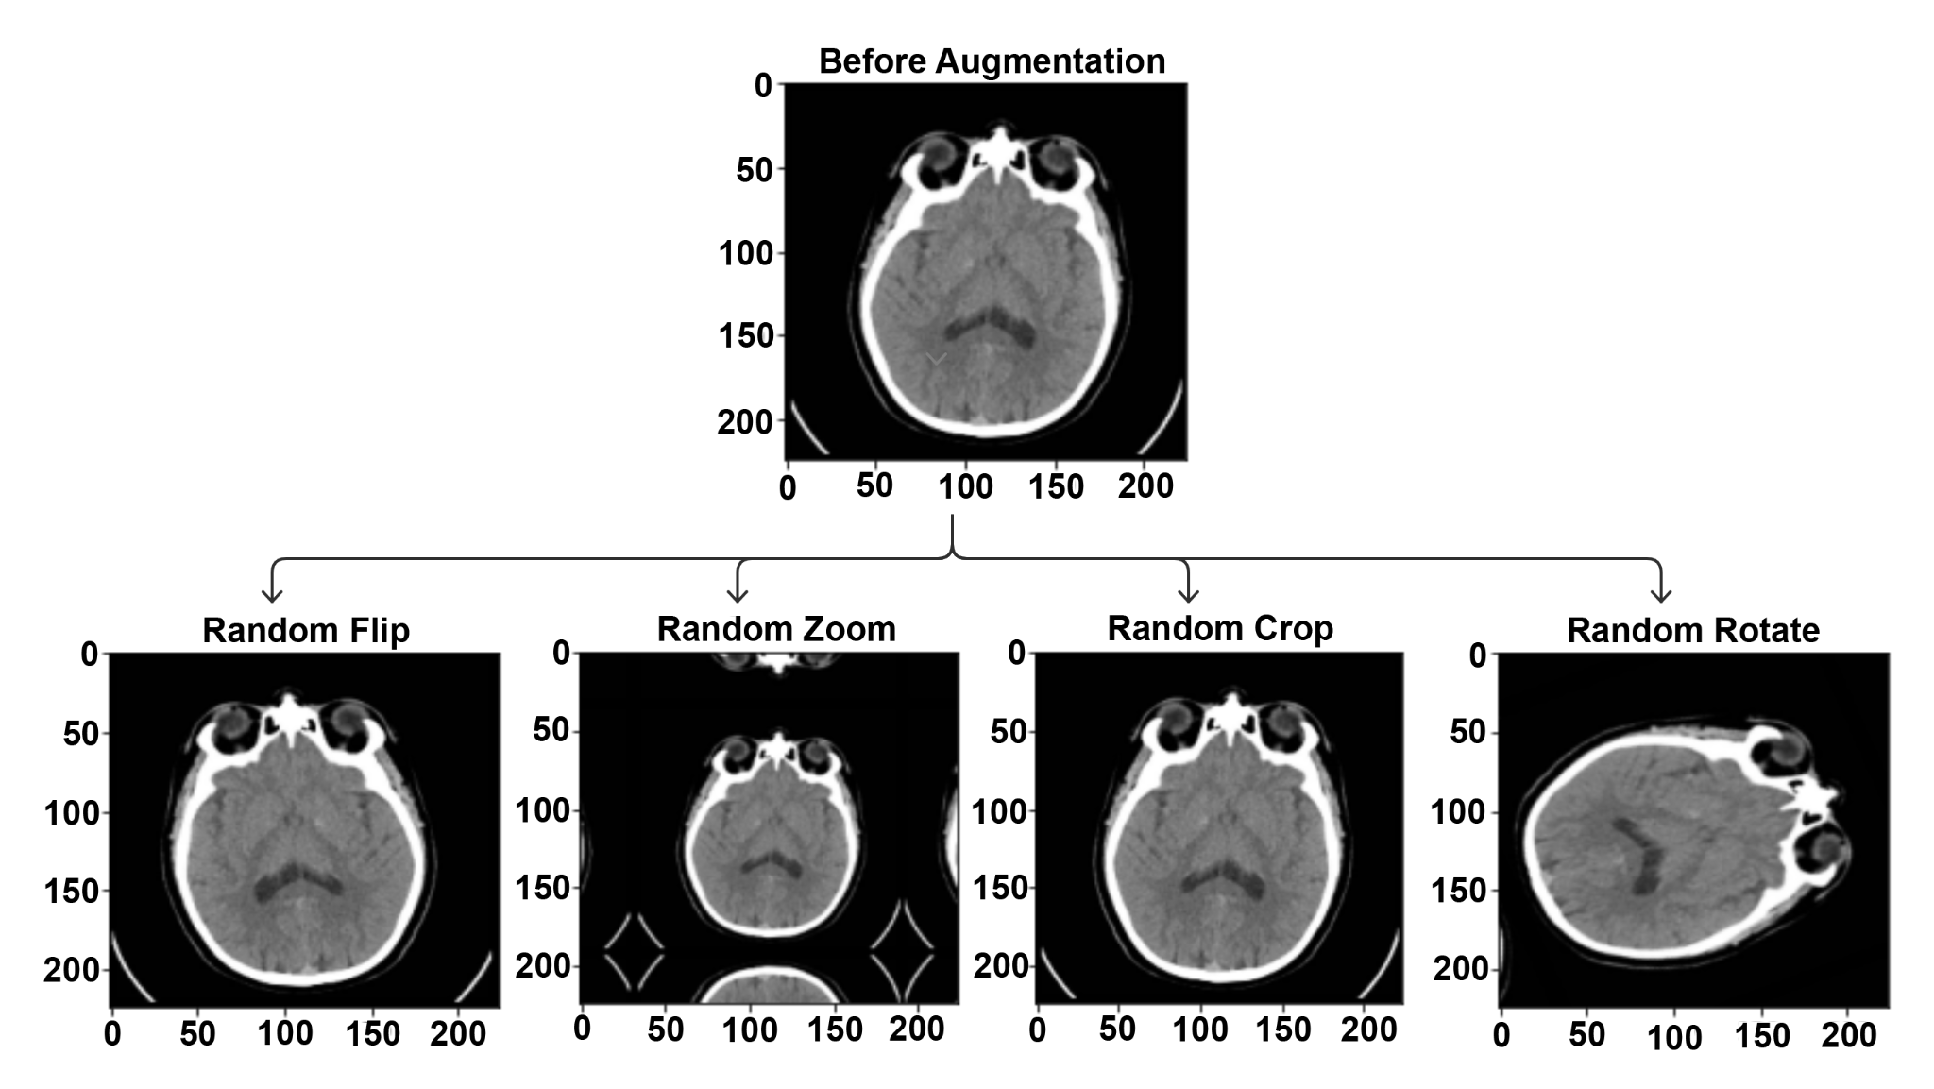
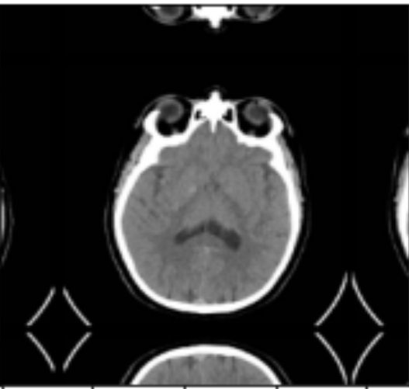
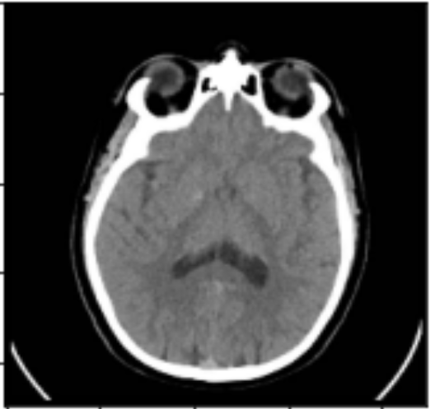
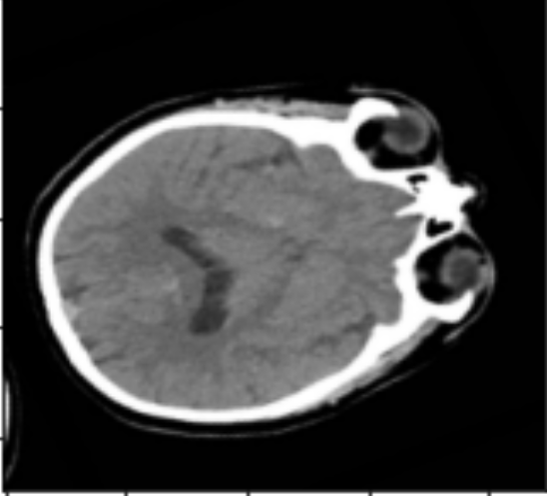
Pre- Processing
Image resizing
We resized all the image to 224*224
Batch size: 32
Data Augmentation
We applied the following transformation to training dataset

Slide 21
04
MODEL DEVELOPMENT
By Afridi Ibn Rahman

Slide 22

Convolutional Neural Network
CNN is best known image classification and image recognition for its high accuracy
CNN
ANN
MLP
SVM
RNN
LSTM
Notes:
ANN, RNN, LSTM, MLP, SVM

Slide 23
Methodology
01
Evaluate Performances
Build a 11 Layer CNN Model
05
Deploy The Best Performing Model
02
Load Pre-Trained Models
Add Hyperparameters
04
03
Add Optimizations

Slide 24
Proposing a New 11-Layered CNN Model
Convolutional Layer
Pooling Layer
Fully Connected Layer
A Total of 4 - Conv2d layers have selected here
4 - Maxpooling2D layers have been used here
Composed of 1 flatten layer and 2 dense layer with Sigmoid Activation

Slide 25
Pre-Trained CNN Models
VGG
VGG16
VGG19
DenseNet
DenseNet121
DenseNet169
DenseNet201
ResNet
ResNet50
ResNet101
ResNet152
Inception
InceptionV1
InceptionV2
InceptionV3
EfficientNet
EfficientNetB0
EfficientNetB1
EfficientNetB2
EfficientNetB3
VGG
VGG16
VGG19
DenseNet
DenseNet121
DenseNet169
DenseNet201
ResNet
ResNet50
ResNet101
ResNet152
Inception
InceptionV1
InceptionV2
InceptionV3
EfficientNet
EfficientNetB0
EfficientNetB1
EfficientNetB2
EfficientNetB3
VGG16
DenseNet121
ResNet50
InceptionV3
InceptionResNetv2
EfficientNetB6
VGG16
DenseNet121
ResNet50
InceptionV3
VGG16
VGG16
DenseNet121
VGG16
DenseNet121
ResNet50

Slide 26
Optimizations
Dropout of 40%
Regularization technique of type L1 and L2
Adam replacement optimization algorithm

Slide 27
05
MODEL EVALUATION
By Ziad Hasan Reza

Slide 28
Performance Metrics
Accuracy
Precision
F1-Score
Recall

Slide 29
Experimental Analysis
EfficientNetB6 has accomplished highest accuracy
Models | Accuracy | Precision | Recall | F1
EfficientNetB6 | 95.99% | 97.52% | 94.40% | 95.93%
DenseNet121 | 95.59% | 92.53% | 99.20% | 95.75%
Resnet50 | 94.40% | 92.37% | 96.80% | 94.53%
InceptionResNetV2 | 90.79% | 88.64% | 93.60% | 91.05%
InceptionV3 | 87.99% | 86.82% | 89.60% | 88.19%
VGG16 | 70.80% | 80.95% | 54.40% | 65.07%
Traditional CNN model | 50.00% | 50.00% | 100.00% | 66.67%

Slide 30
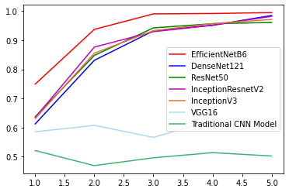
Auc
AUC : The Area Under the Curve (AUC) is the measurement of the ability of a classifier to differentiate among the classes
Notes:
ANN, RNN, LSTM, MLP, SVM

Slide 31
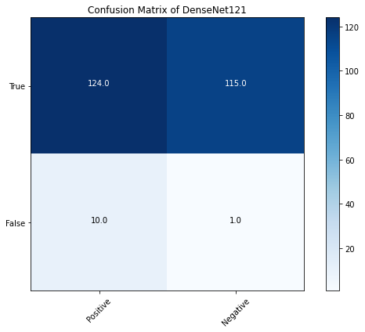
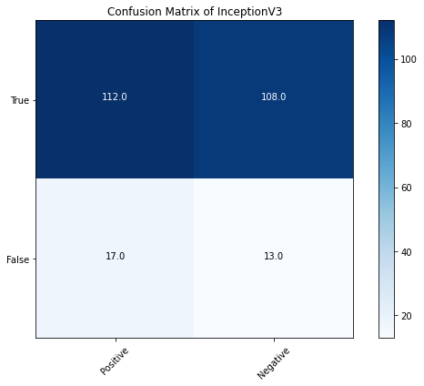
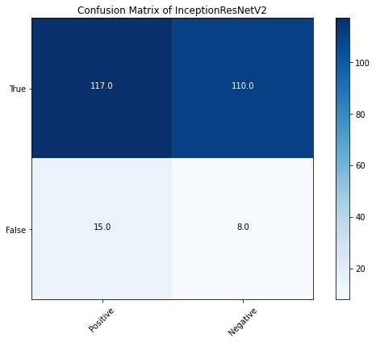
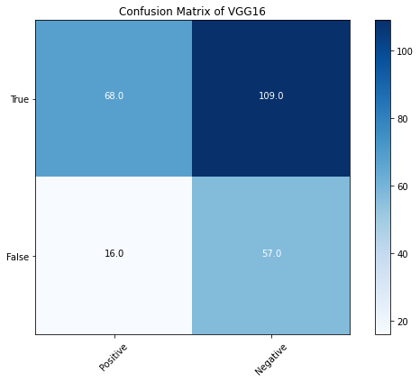
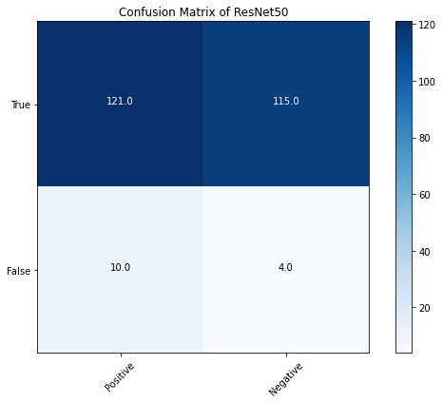
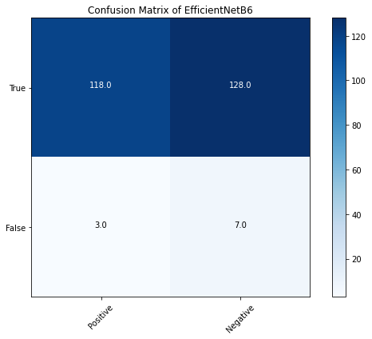
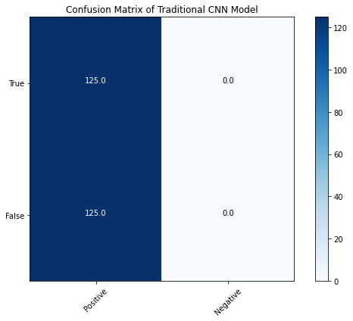
CONFUSION MATRIX
EfficientNetB6
DenseNet121
Resnet50
InceptionResNetV2
InceptionV3
VGG16
Traditional CNN model

Slide 32
CONFUSION MATRIX
 | Confusion Matrix
Models | TP | TN | FP | FN
EfficientNetB6 | 118 | 122 | 3 | 7
DenseNet121 | 124 | 115 | 10 | 1
Resnet50 | 121 | 115 | 10 | 4
InceptionResNetV2 | 117 | 110 | 15 | 8
InceptionV3 | 112 | 108 | 17 | 13
VGG16 | 68 | 109 | 16 | 57
Traditional CNN model | 125 | 0 | 125 | 0

Slide 33
06
DISCUSSION
By Tasin Al Nahian Khan

Slide 34
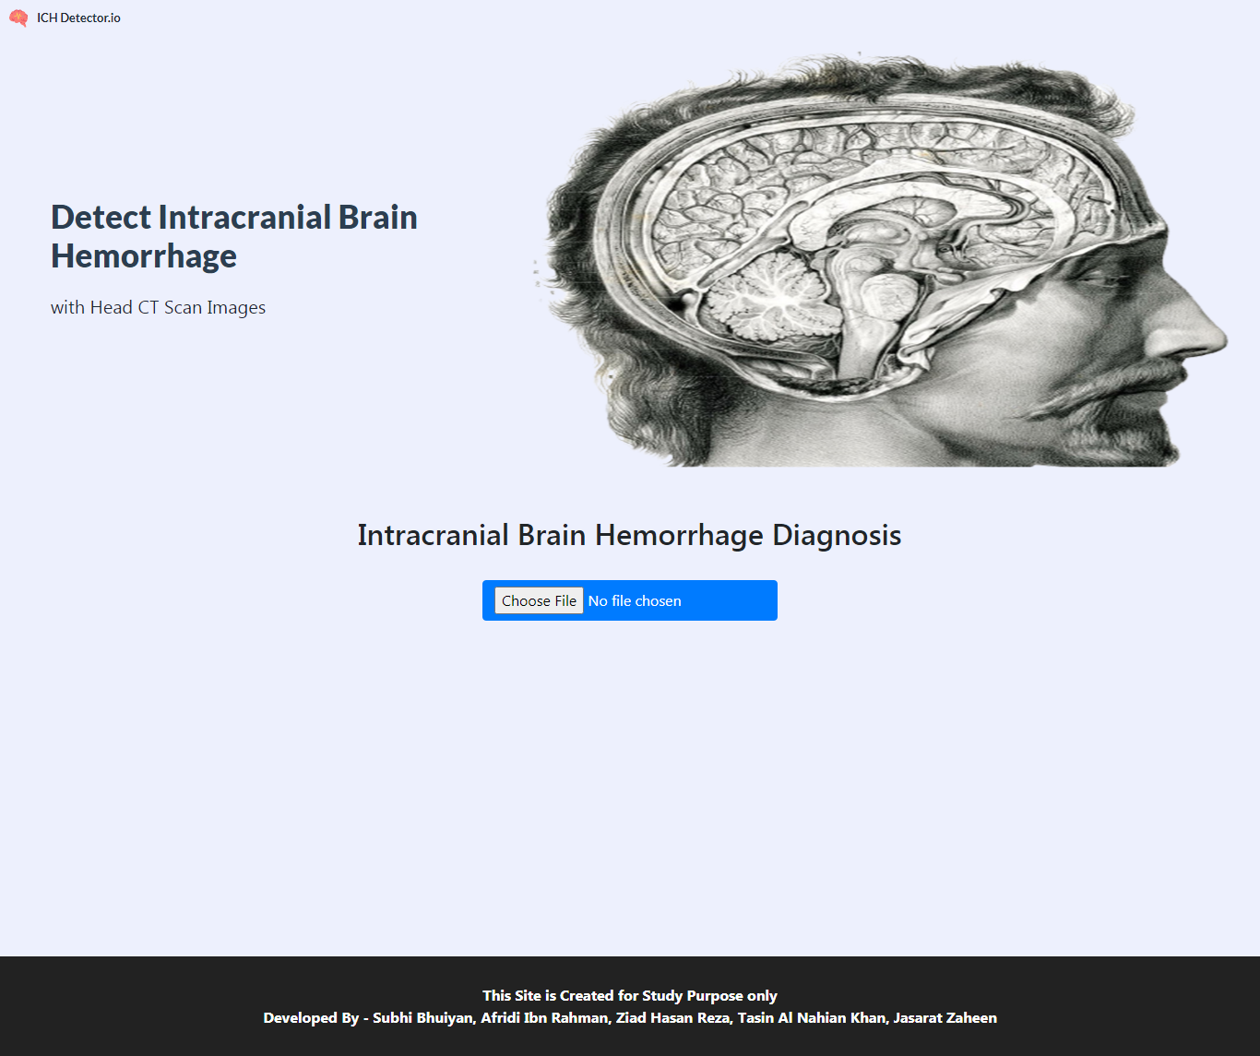
Web Application
Developed Intracranial Brain Hemorrhage detector with EfficientNetB6
Uses CT scan images to detect
Differentiate between healthy brain images and hemorrhage images

Slide 35
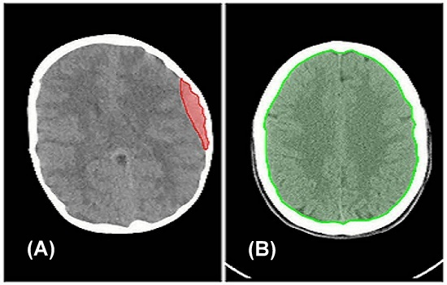
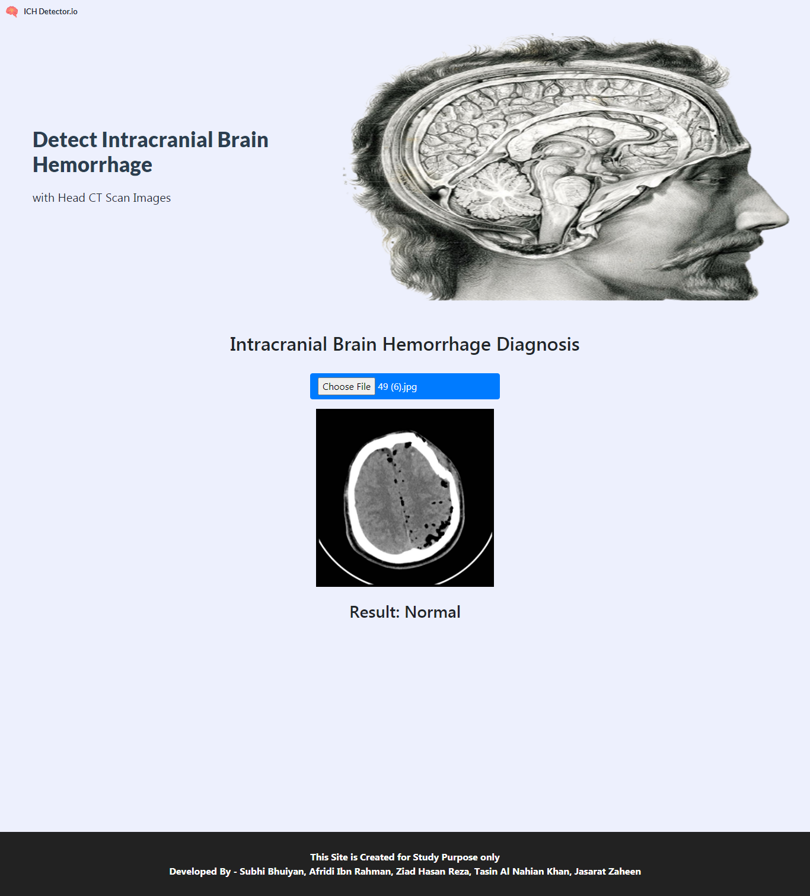
Deployment Considerations
Runs on python 3.6, tensorflow 2, flask, Gevent
Added Scikit Learn and Scikit Image libraries
It was first built on local machine and hosted on Heroku
Gives output in only 4–10 seconds
Secure patient confidentiality.

Slide 36
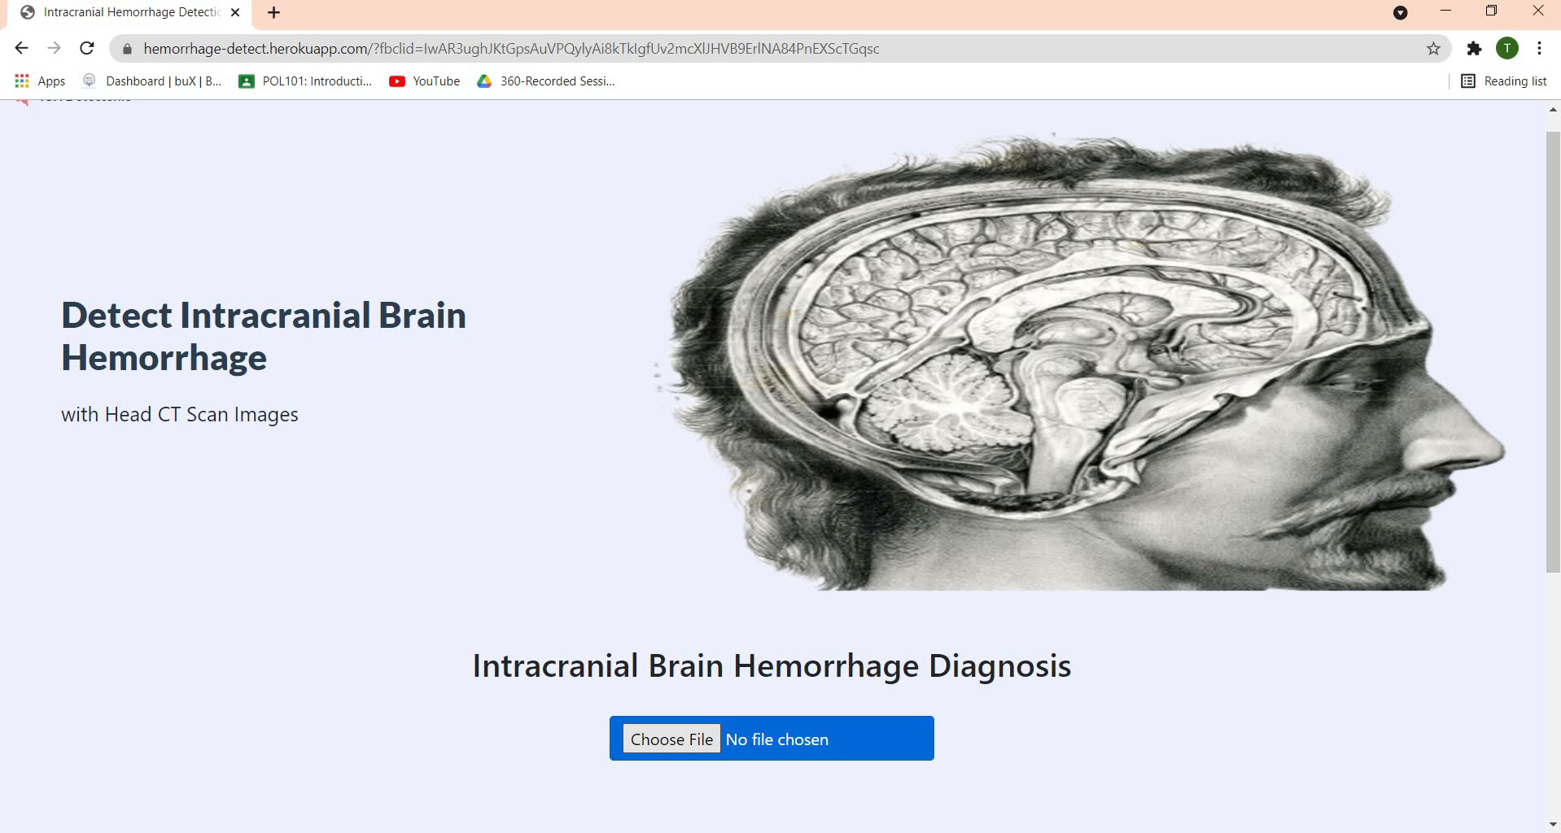

Slide 37
Scope
Train 7 CNN models
Aid doctors make faster and precise diagnoses
95.99%
EfficientNetB6
Improve clinical diagnosis
Efficiently diagnose Intracranial Hemorrhage

Slide 38
Limitations
Model lacks to incorporate patients history
Dataset lacks supplementary information
Data itself is incoherent, can result to cases of misdiagnosis

Slide 39
07
CONCLUSION
By Tasin Al Nahian Khan

Slide 40
Model Summary
01
02
03
Uses CT scan images
Binary classification between Hemorrhage and Non Hemorrhage images
Uses EfficientNetB6 as the base model

Slide 41
Future Work
To implement multi-class classification
Use ensemble techniques to obtain better predictive performance
Widen our research to other parts of the brain

Slide 42
Thank You

